Slide 1
DENSITY BASED CLUSTERING
Identifies clusters as areas of high density separated by regions of low density in the dataspace.
Unlike centroid based methods density based clustering automatically determines the number of clusters.
Popular algorithms-DBSCAN,OPTICS,mean shift

Slide 2
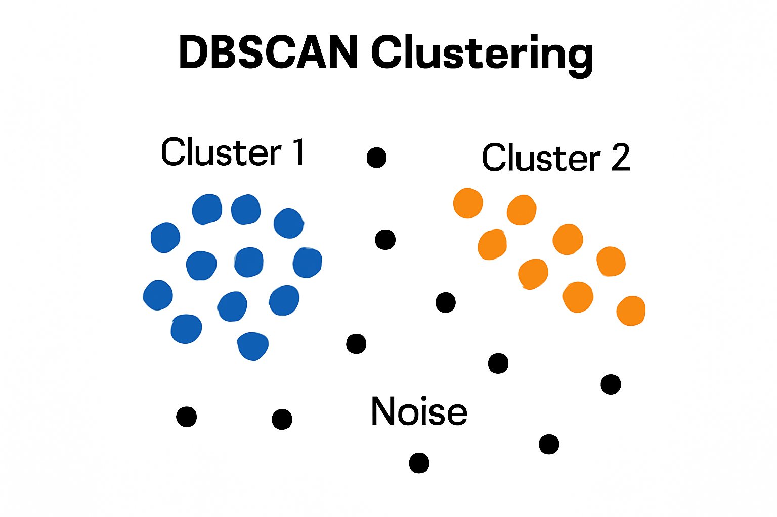

Slide 3
DBSCAN Characteristics
Can Find arbitrary shaped clusters
Handles noise and outliers well
Excels with clusters of different size and shapes.
Ideal for datasets with irregularly shaped or overlapping clusters.

Slide 4
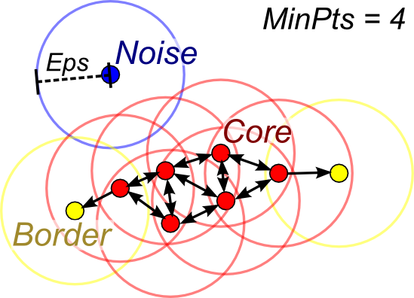
DBSCAN-Density Based Spatial Clustering of Applications with Noise

Slide 5
DBSCAN
KEY PARAMETERS
Epsilon-Radius of neighborhood around a datapoint.
Minpoints-Minimum number of points required with in the radius epsilon to form a dense region.

Slide 6
DBSCAN works by categorizing data points into three types
Core points
Border Points
Noise Points

Slide 7
Core point
A core point should have sufficient number of neighbours with in the specified radius(epsilon)
Border Point
A Border point is a point near the core point but lack enough neighbors to be core point themselves.
Noise point
Noise point is the point that does not belong to any cluster

Slide 8
Working
By iteratively expanding clusters from core points and connecting density-reachable points, DBSCAN forms clusters without relying on rigid assumptions about their shape or size.
Disadvantage
It does not allow clustering of varying density

Slide 9
Ordering Points To Identify the Clustering Structure-OPTICS
OPTICS does not directly assign clusters but instead creates a reachability plot which visually represents clusters.
OPTICS produces ordering for density based clusters
Key Concepts
Core Distance:
The minimum distance needed for a point to be classified as a core point(called as Epsilon dash)
Reachability Distance
It is a measure of how difficult it is to reach from one point to another.

Slide 10
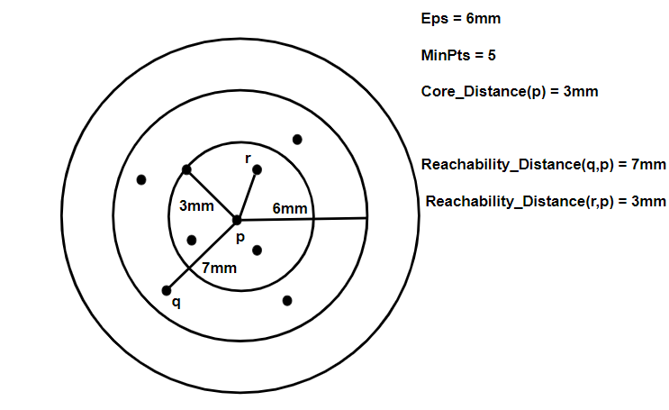

Slide 11
Working of OPTICS
The algorithm selects a starting point and checks if it has at least MinPts neighbors within Eps.
If the point meets the density requirement it is marked as a core point and nearby points are then analyzed.
Reachability distance is computed for each neighboring point.
Points are then processed in order of their reachability distance hence forming a reachability plot.
Clusters appear as valleys i.e low reachability distances and noise appears as peaks i.e high reachability distances.

Slide 12
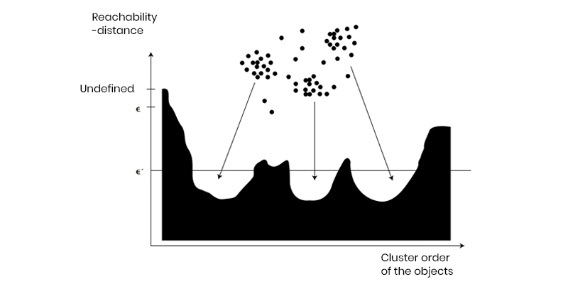

Slide 13
Advantage
Cluster ordering is important to extract the basic clustering information.
Disadvantage
It only produces cluster ordering.
It can’t handle high dimensional data.

Slide 14
Mean shift
Mean Shift is a centroid-based, density-based clustering algorithm.
It does not require the number of clusters to be specified in advance.
It works by shifting each data point toward the mode (peak) of the data distribution using a sliding window (kernel or radius).

Slide 15
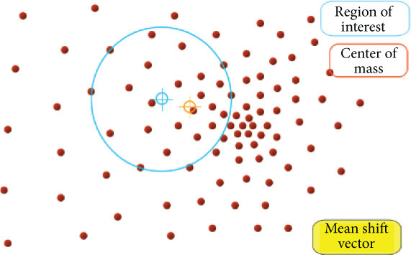
Mean shift Clustering

Slide 16
Let’s assume the bandwidth (radius) of the kernel is 2 units.
Point | Coordinates (x, y)
A | (1, 1)
B | (1.5, 1.5)
C | (5, 5)
D | (6, 5.5)
E | (1, 0.5)

Slide 17
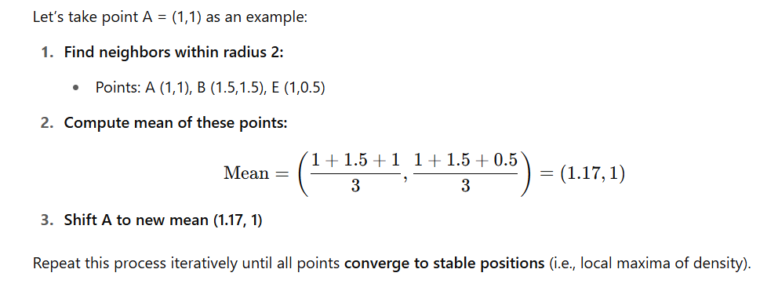
Step by Step working

Slide 18
Disadvantage
Computationally expensive

Slide 19
Connectivity Based Clustering(Hierarchical Clustering)
Builds a hierarchy of clusters using a measure of connectivity based on distance when organizing a collection of items based on their similarities.
This method builds a dendrogram, a tree-like structure that visually represents the relationships between objects.
Popular Algorithms
Agglomerative(BIRCH)
Divisive

Slide 20
Balanced Iterative Reducing and Clustering using Hierarchies(BIRCH)
Cluster large datasets by first generating a small and compact summary of the large dataset that retains as much information as possible.
Key Parameters
Clustering Feature (CF)
CF - Tree Clustering Feature (CF)

Slide 21
Clustering Feature entry is defined as an ordered triple, (N, LS, SS) where,
'N' is the number of data points in the cluster,
'LS' is the linear sum of the data points and
'SS' is the squared sum of the data points in the cluster. It is possible for a CF entry to be composed of other CF entries
CF tree
A tree where each leaf node contains a sub-cluster. Every entry in a CF tree contains a pointer to a child node and a CF entry made up of the sum of CF entries in the child nodes. There is a maximum number of entries in each leaf node. This maximum number is called the threshold

Slide 22
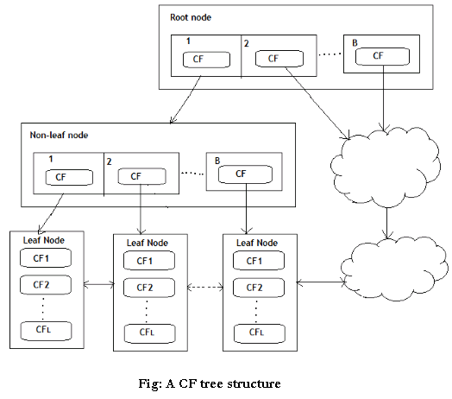
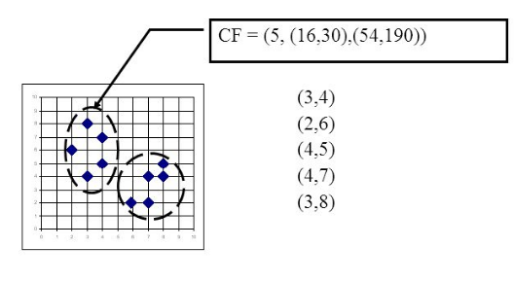
BIRCH Clustering

Slide 23
Similarity Based clustering
Affinity propogation
One of the standout features of Affinity Propagation is that it automatically determines the number of clusters based on the data, eliminating the need to predefine this parameter.

Slide 24
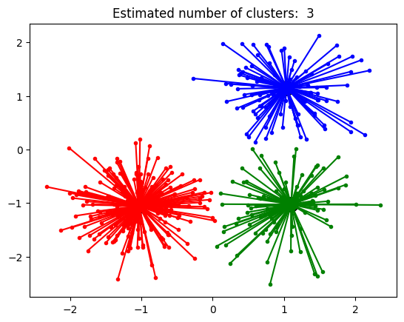
Affinity propagation

Slide 25
Exemplars:
Each data point can be considered an exemplar (or representative) of its own cluster and can also have a preference for being the exemplar of other data points.
Messages:
The algorithm iteratively passes messages between data points, reflecting their suitability for one another to be exemplars.
Responsibilities and Availabilities:
Two matrices, "responsibility" and "availability," are used to keep track of the messages being passed and updated during the iterations.
Convergence:
The iterations continue until a high-quality set of exemplars and corresponding clusters emerges, and the algorithm converges.
No Predefined Number of Clusters:
Affinity Propagation determines the number of clusters automatically, unlike some algorithms that require the number of clusters to be specified.

Slide 26
Spectral Clustering
A popular unsupervised machine learning algorithm used to group data points into clusters.
It works especially well when the clusters are non-convex or not linearly separable.
Spectral clustering uses the spectrum (eigenvalues and eigenvectors) of a similarity matrix of the data to perform dimensionality reduction, followed by a standard clustering algorithm in the reduced space.

Slide 27
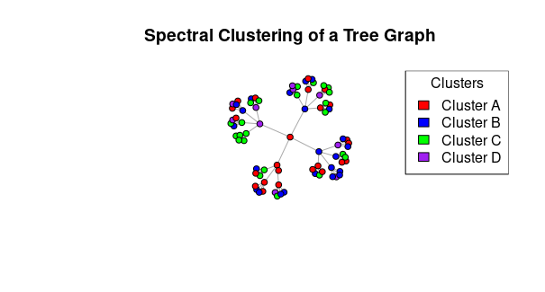
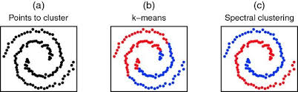
Spectral clustering

Slide 28
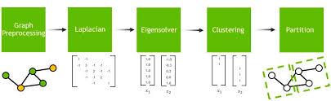

Slide 29
Spectral Clustering
Imagine each data point as a node in a graph.
If two points are similar, connect them with a strong edge (high weight).
Then, use the spectrum (eigenvalues/eigenvectors) of this graph to find natural groupings in the data.

Slide 30
Steps in Spectral clustering
Preprocessing
Constructing Laplacian matrix by computing adjacency matrix and degree matrix
Decomposition
Compute Eigen vector and eigen value
Grouping
Assign points or nodes to cluster

Slide 31
Spectral Clustering
Disadvantage
Number of clusters should be specified in advance
Computationally expensive
Need to choose the right similarity measure

